Slide 1




GEN AI
GENERATIVE AI - CURRENT TRENDS AND FUTURE APPLICATIONS
Annapurna Devarakonda
COMPARITIVE ANALYSIS AND FUTURE OUTLOOK

Slide 2
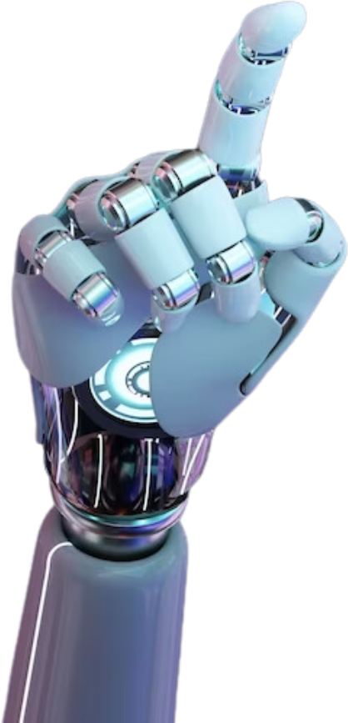

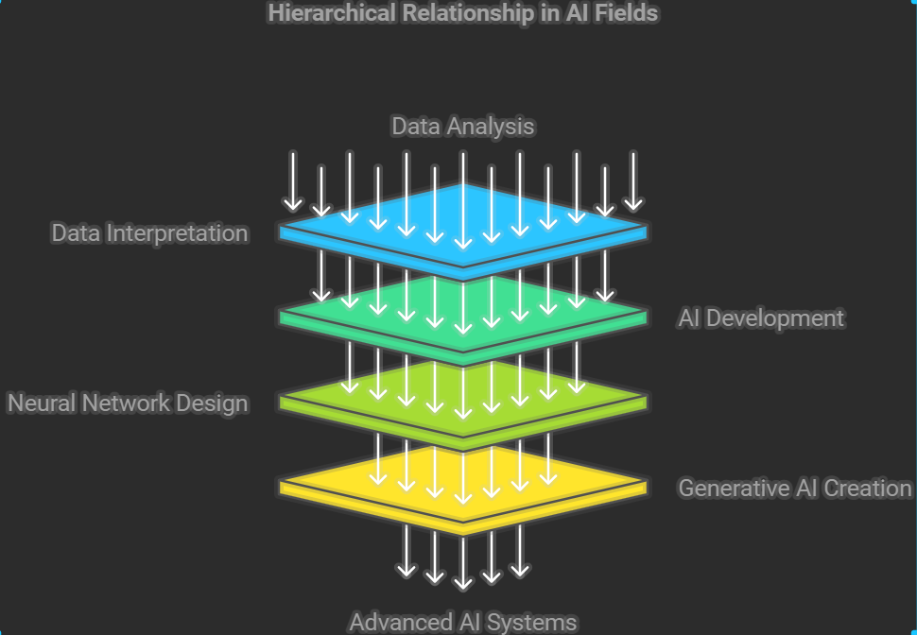
GEN AI
Data Science vs AI vs Neural Networks vs GEN AI
Notes:
Data Science - Focuses on analyzing and interpreting data to extract insights.
AI - Broad field aiming to create machines that can mimic human intelligence.
Neural Networks - Algorithms modeled after the human brain, key to both AI and Generative AI.
Gen AI - A subset of AI that generates new content (text, images, etc.) based on learned data.

Slide 3
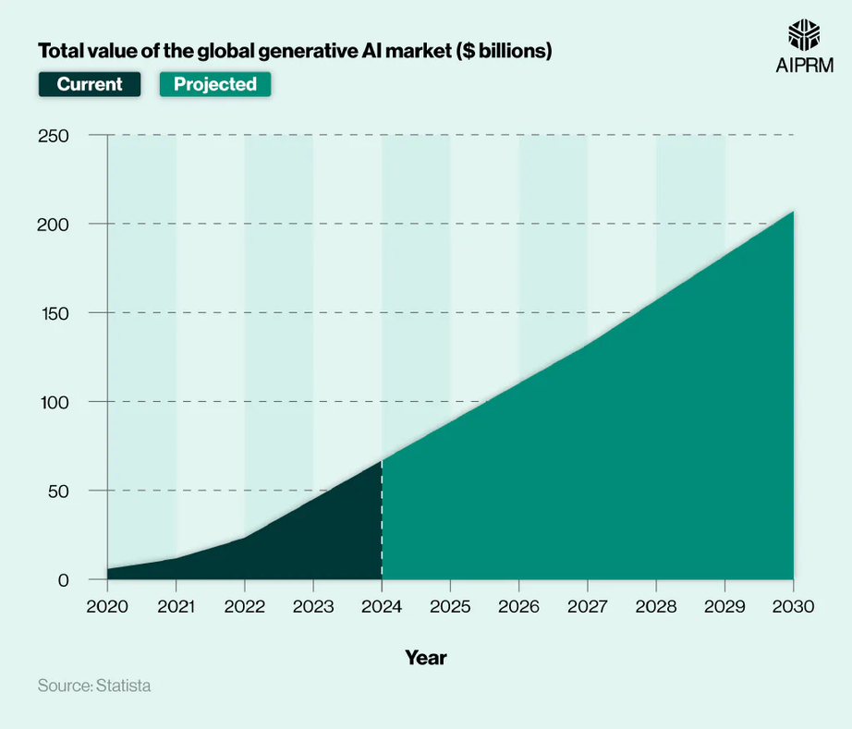

GEN AI
Current Trends - Gen AI
Valued at $45 billion in 2024, expected to grow to $60 billion by 2025 and upto > $200 billion by 2030.
Increasing demand for automation, personalization, and content creation across industries such as healthcare, manufacturing, and automotive is fueling market growth

Slide 4
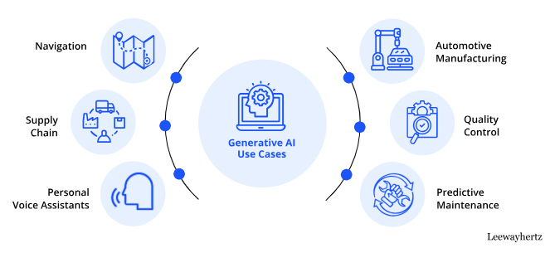
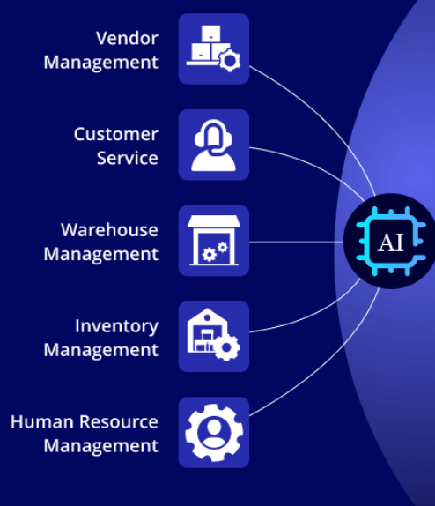
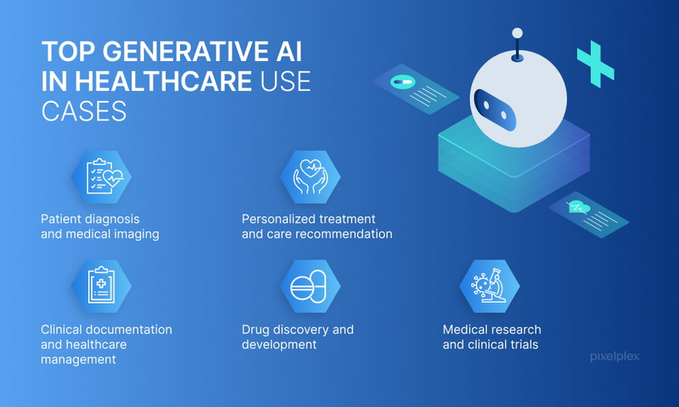

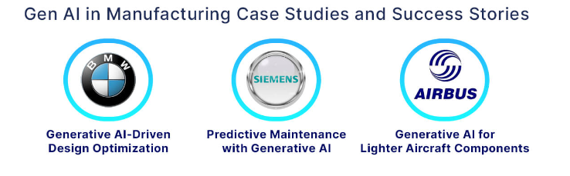
ACROSS INDUSTRIES
GEN AI
AUTOMOTIVE INDUSTRY
SUPPLYCHAIN INDUSTRY
HEALTHCARE INDUSTRY
MANUFACTURING INDUSTRY
Notes:
In the Supply Chain sector, Gen AI is being applied to:
* Vendor Management: Automating vendor selection and contract negotiations.
Customer Service: Enhancing customer interactions with AI-powered chatbots and personalized assistance.
Warehouse Management: Optimizing inventory placement and reducing operational costs through predictive analytics.
Inventory Management: Predicting demand patterns to ensure optimal stock levels, reducing overstocking or stockouts.
Human Resource Management: Streamlining hiring processes, employee training, and workforce planning using AI-driven insights.
In the automotive sector, Gen AI is revolutionizing
Navigation Systems: AI-powered navigation systems provide real-time route optimization based on traffic conditions.
Supply Chain Optimization: Ensures timely delivery of parts and materials, improving production timelines.
Personal Voice Assistants: Enhancing in-car experiences with voice-activated systems that can control vehicle functions and provide personalized recommendations.
Automotive Manufacturing: Automating the design process and improving production line efficiency through generative design tools.
Quality Control: Using AI to detect defects in real-time during manufacturing, reducing waste and improving product quality.
Predictive Maintenance: Monitoring vehicle health to predict when maintenance is needed before a breakdown occurs.
In manufacturing, Gen AI is being used for:
AI-Driven Design Optimization (BMW): Generative design tools help BMW create lighter, more efficient vehicle components, reducing material costs while maintaining safety standards.
Predictive Maintenance (Siemens): Siemens uses AI to predict equipment failures before they happen, minimizing downtime and improving operational efficiency.
Lighter Aircraft Components (Airbus): Airbus leverages generative AI to design lighter aircraft components, improving fuel efficiency and reducing emissions.
In healthcare, Gen AI has several critical applications:
Patient Diagnosis & Medical Imaging: AI models assist in analyzing medical images for faster and more accurate diagnoses.
Personalized Treatment & Care Recommendations: Gen AI helps create personalized treatment plans based on patient data, improving outcomes.
Clinical Documentation & Healthcare Management: Automating administrative tasks like clinical documentation reduces the burden on healthcare professionals.
Drug Discovery & Development: Accelerates the drug discovery process by simulating molecular interactions and predicting potential drug candidates.
Medical Research & Clinical Trials: AI models analyze vast amounts of data from clinical trials to identify patterns that might be missed by human researchers.
Across these industries, we see that generative AI is not just automating tasks but also enabling new possibilities for innovation. Whether it’s optimizing supply chains or assisting in personalized healthcare treatments, the impact of GenAI is profound and growing rapidly.

Slide 5
CHANGING DYNAMICS
YEAR | TRADITIONAL SYSTEMS | AI ADOPTION | CLOUD
2022 | DOMINANT | EMERGING | GROWING
2023 | DECLINING | EXPANDING | STRONG GROWTH
2024 | LIMITED | MAINSTREAM | WIDESPREAD
2025 | MINIMAL | UBIQUITOUS | DOMINANT
Cloud computing Traditional IT systems
AI adoption cloud integration

Slide 6


GEN AI
Technological Advancements in Generative AI
2020
2021
2022
2023
2024
2025
GANs improvement by NVIDIA
DALL-E and CLIP by OPENAI
CHATGPT release by OPENAI
GPT-4 release by OPENAI
CHATGPT-5 and Orion expected release
Increased adoption of diffusion models
Notes:
Key Technological Advancements in Generative AI (2020-2025)
2020: GANs Improvement by Nvidia:Generative Adversarial Networks (GANs), first introduced in 2014, saw significant improvements in 2020, particularly by companies like Nvidia. These advancements allowed for more realistic image generation and better training stability, pushing forward AI's ability to generate high-quality visual content.
2021: DALL-E and CLIP by OpenAI:OpenAI released DALL-E in early 2021, a model capable of generating images from textual descriptions, marking a breakthrough in text-to-image generation.
Later in 2021, OpenAI introduced CLIP, a model that understands images and text together, enabling more accurate image generation based on natural language prompts.
2022: ChatGPT Release by OpenAI:In November 2022, OpenAI launched ChatGPT, a conversational AI model based on GPT-3. This model revolutionized natural language processing (NLP) by providing human-like responses, leading to widespread adoption across industries.
2023: GPT-4 Release by OpenAI:In March 2023, OpenAI released GPT-4, an even more powerful large language model (LLM) with improved reasoning, context understanding, and multimodal capabilities (handling both text and images). This marked a significant leap in generative AI's ability to handle complex queries and tasks.
2024: ChatGPT-5 and Orion Expected Release:By late 2024, OpenAI is expected to release ChatGPT-5, internally referred to as "Orion." This version is anticipated to have enhanced reasoning capabilities and multimodal support, allowing it to process and generate text, images, audio, and video more effectively.
2025: Increased Adoption of Diffusion Models:Diffusion models are expected to gain widespread adoption by 2025 due to their superior performance in generating high-quality images compared to GANs. These models work by progressively adding noise to data and then learning to reverse the process, resulting in highly realistic image generation.

Slide 7
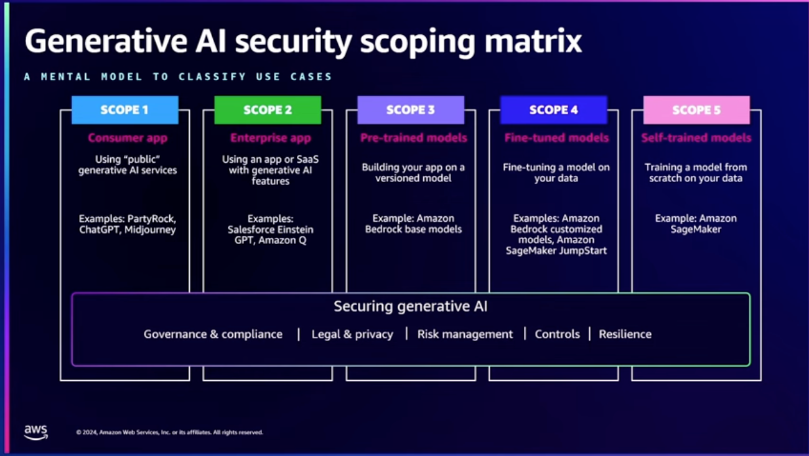
GEN AI
WAY FORWARD and CONCLUSION
Employing LoRA for efficient fine-tuning
Using platforms like Hugging Face or custom ChatGPT applications to build domain-specific solutions
Notes:
Organizations should focus on the strategic adoption of generative AI by: Leveraging frameworks like the Generative AI Security Scoping Matrix to assess security risks and ensure compliance during AI deployment Employing LoRA for efficient fine-tuning of large models to reduce costs while maintaining high performance Using platforms like Hugging Face or custom ChatGPT applications to build domain-specific solutions that enhance productivity and innovation across sectors such as healthcare, manufacturing, automotive, and logistics

Slide 8
Future Jobs
Data Scientist: Analyzing large datasets to derive insights and build predictive models.
AI Engineer: Designing and implementing AI systems and algorithms.
Machine Learning Engineer: Developing and training machine learning models.
AI Ethicist: Ensuring AI systems are developed and used ethically and responsibly.
AI Product Manager: Overseeing the development and deployment of AI products.
AI Research Scientist: Conducting research to advance AI technologies.
AI Policy Analyst: Developing policies and regulations for AI use.
AI-Trained Customer Support Specialist: Using AI tools to provide efficient customer support.
AI-Trained Content Creator: Generating creative content using AI tools.
AI-Trained Software Developer: Using AI to automate and enhance software development processes.

